Slide 1
Targeted Synthetic BLE Packet Data Generation Approach
17.03.2025
Keisuke Yokota

Slide 2
Executive Summary
Recap of Previous Presentation
Results
Index
Design
Implementation / Evaluation Plan
Conclusion

Slide 3
Executive Summary
Introduction
Background
Index
Design
Implementation / Evaluation Plan
Conclusion

Slide 4



Executive Summary
The Goal
Investigate the usefulness of the Markov model in synthesizing data in BLE packets
Clarify that a Markov model is appropriate for creating BLE data
Create a synthesis data of BLE using a Markov model
Evaluate the synthetic data
The Method
Generated synthetic data with the Markov model
Investigated the characteristics of each method and the features of BLE packet data
Implemented the Markov model
The Results
Confirmed that synthetic data produced by the Markov model improved the ML model
Compared the structure of data with synthetic data and the original data
Compared the confidence levels between models with and without synthetic data

Slide 5
Executive Summary
Recap of Previous Presentation
Background
Index
Design
Implementation / Evaluation Plan
Conclusion

Slide 6



The current state of BLE
BLE is Abused
The Need for Synthetic Data
Importance of large dataset
Large dataset
Diverse dataset
Examples of BLE Abuse
AirTag is slipped into a car to obtain location data illegally (Bern, 2022)
A woman used an AirTag to track her boyfriend and later killed him (US, 2022)
A woman was stalked by her ex-boyfriend using an AirTag, and she was ultimately shot with a gun. (US 2022)
Cost and Risk
Time and monetary cost
Privacy issues
It is important to develop a model
to detect and classify BLE devices
Synthetic data resolves these problems
https://www.statista.com/statistics/750569/worldwide-bluetooth-low-energy-device-market-volume/, https://www.20min.ch/story/ich-hatte-panik-bernerin-19-findet-fremden-airtag-unter-ihrem-beifahrersitz-460234987350, https://www.nzz.ch/panorama/airtag-stalking-hat-apple-die-gefahr-unterschaetzt-ld.1688765?reduced=true
BLE is abused.
Notes:
↓AirTagを使用した事件
https://ascii.jp/elem/000/004/219/4219026/

Slide 7





Research questions
Clarify to be a Markov model appropriate for creating BLE data
Goals
Create synthesis data of BLE using
a Markov model
Evaluate the synthetic data
Notes:
The objective of this research is to generate high-quality synthetic data of BLE packets using the Markov model.

Slide 8
Method Selection
Markov Model
Hidden Markov Model
GAN
Suitable for time-series data
Suitable for structured data
Suitable for complex structured data
Suitable when interested in the underlying states of the data
Ensuring data diversity
Not suitable for structured data
BLE packet data is time-series and structured data.
The main goal is to generate synthetic data, not investigate hidden states.
BLE is structured data.
Notes:
Given that BLE packet data has a defined structure and is time-series in nature, the Markov Model is chosen.
BLEパケットデータは構造が決まっていることと、時系列データであることからマルコフモデルを選択する。

Slide 9



Data Selection
Preprocessed SmartTag (nearby)
SmartTag (nearby)
Preprocessed
Small data volume
Can be compared with Stefan's results
Low accuracy
The existing model
can be used

Slide 10
Synthetic Data Generation Pipeline

Slide 11


Example of the State Transition
State Transition Model
State Transition Matrix
CH 39
CH 38
CH 37
CH 39
0.000000
0.000419
0.999581
CH 38
0.333054
0.001398
0.665549
CH 37
0.000069
0.492758
0.507173

Slide 12
Executive Summary
Results
Background
Index
Design
Implementation / Evaluation Plan
Conclusion

Slide 13

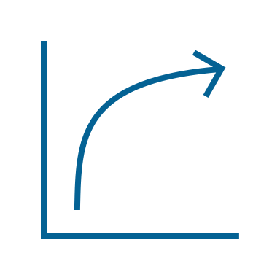
Evaluation Perspectives
Data Structure
Confidence Lebel
Compare the structure of data with synthetic data and original data.
Compare confidence levels between models with and without synthetic data.
Notes:
The next task is to evaluate the synthetic data. The evaluation will be conducted from two perspectives.

Slide 14
Comparison of Data Structures
Diagram
Matrix
CH 37
CH 38
CH 39
Original
60.316998
29.765371
9.917630
Synthetic
60.334167
29.711667
9.954167
No significant structural difference between original and synthetic datasets

Slide 15
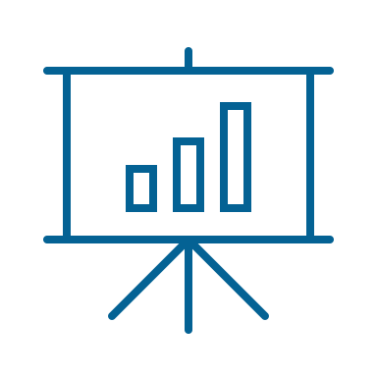
Comparison of Data Structures
Length
Advertising Data type

Slide 16
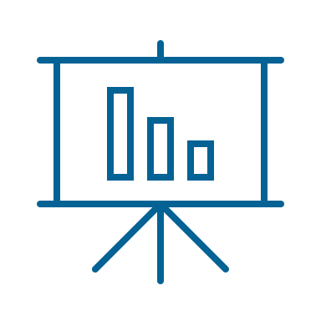
1012 ボックス (左右3分割・タイトル部アイコン+テキスト)
PDU
UUID
SmartTag type

Slide 17

Comparison of the Models with and without Synthetic Data
Model - o
Model - S
Model - M
Model Type
Neural Network
Neural Network
Neural Network
Data
Original dataset
Original dataset
+ Synthetic dataset
Original dataset
+ Synthetic dataset
Method
-
Duplicating
The Markov model
Details
-
Duplicated misclassified SmartTag (nearby) data from real data and labeled it as 'Other'.
Applied the Markov model to SmartTag (nearby) data obtained inside a Faraday cage.

Slide 18

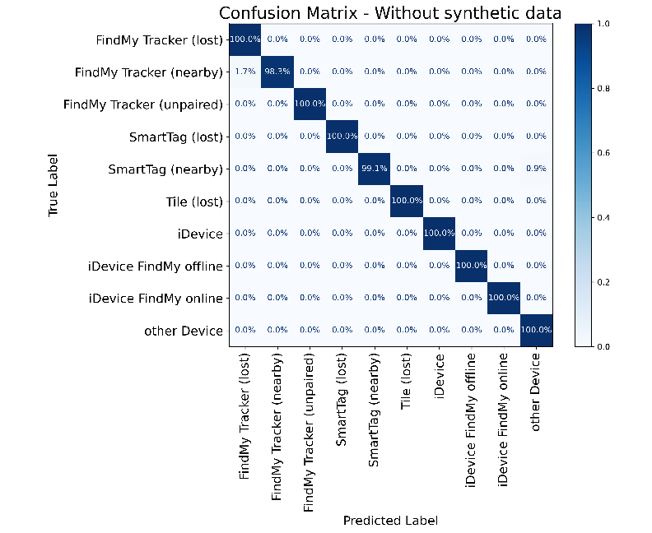
Comparison of Results on Test Data
Confusion Matrix and Results for SmatTag (nearby)
Insights from Test Data
Results for SmatTag (nearby)
Model
Probability
The test data achieve sufficient accuracy even without synthetic data.
The classification accuracy for SmartTag (nearby) in the test data improved further with synthetic data generated by the Markov model.
Model - o
99.1%
Model - s
99.0%
Model - o
99.9%

Slide 19
Comparison of Results with Real Data – SmartTag (nearby)
The synthetic data improves the accuracy for SmartTag (nearby) compared to real data.
Without
Duplicating
Markov model

Slide 20
Comparison of Results with Real Data – Tile (lost)
The synthetic data improves the accuracy for SmartTag (nearby) compared to real data.
グラフ変更
Without
Duplicating
Markov model

Slide 21
Comparison of Results with Real Data – Findmy Tracker (unpaired)
The synthetic data improves the accuracy for SmartTag (nearby) compared to real data.
グラフ変更
Without
Duplicating
Markov model

Slide 22
Results with Varying Synthetic Data Ratio in Training SmartTag (nearby)
0 %
10 %
25 %
グラフ変更
50 %
75 %
100 %

Slide 23
Executive Summary
Discussion and Limitations
Background
Index
Design
Implementation / Evaluation Plan
Conclusion

Slide 24
Discussions

Slide 25
Limitations

Slide 26
Executive Summary
Final Considerations
Background
Index
Design
Implementation / Evaluation Plan
Conclusion

Slide 27


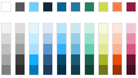


0000 頻出オブジェクト一覧 XXXX XXXX
XXXX
XXXX
XXXX
XXXX
XXXX
XXXX
XXXX
色見本
XXXX
メイン カラー
アクセントカラー
文字 の色
XXXX
XXXX
XXXX
メインで 使用する色
XXXX
１
XXXX
2
Copyright © 2022 by Timewitch. All rights reserved. v10
XXXX
XXXX
XXXX
XXXX
XXXX
XXXX
XXXX
XXXX
XXXX
あああ
あああ
XXXX
必要に応じて 使用する色
XXXX
あああ
XXXX
Note: Source:
要確認

Slide 28
Answer to the RQs

Slide 29
Future work

Slide 30
Questions?

Slide 31
Appendix

Slide 32
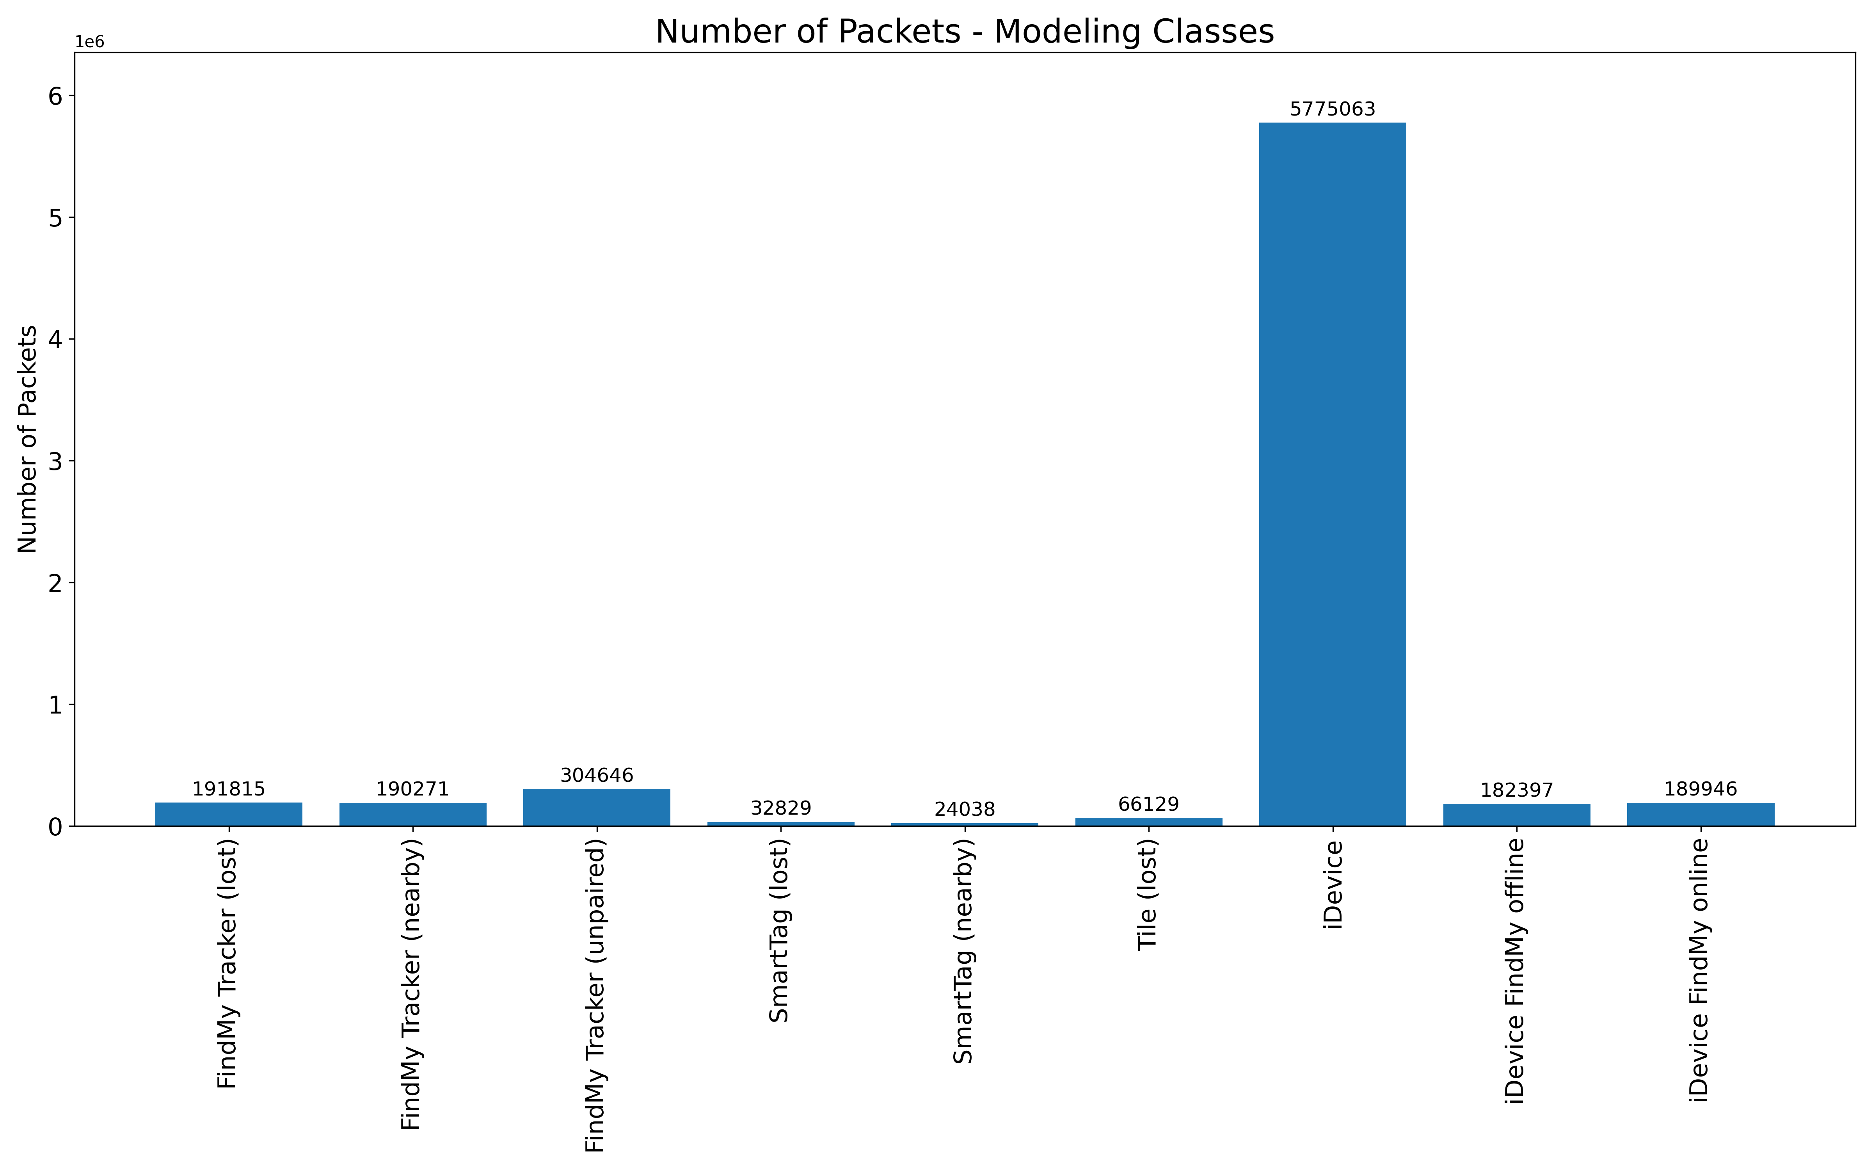
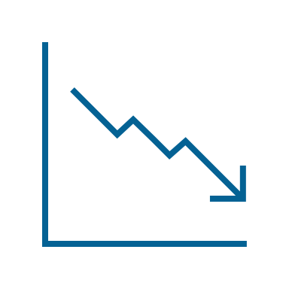
Data Selection (Number of packets)
32

Slide 33

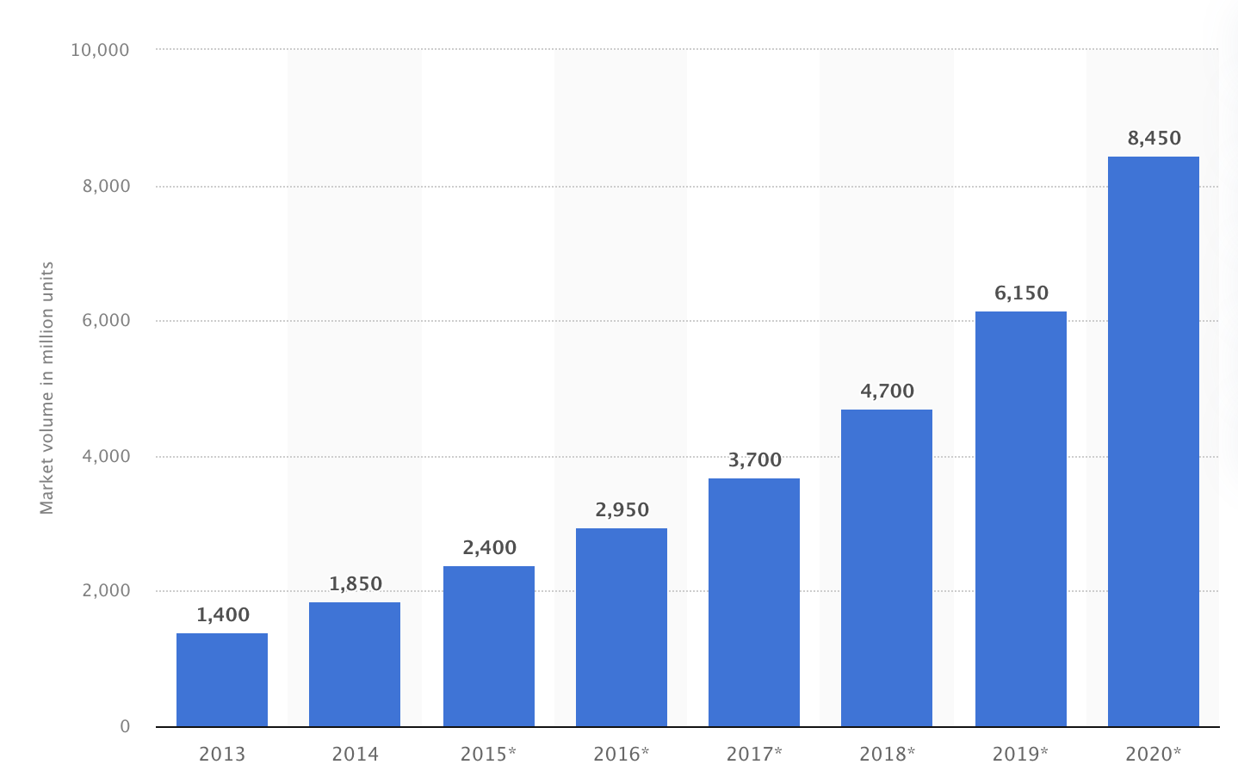
The current state of BLE
BLE devices market volume (in million units)
BLE is abused.
Examples of BLE Abuse
AirTag is slipped into a car to obtain location data illegally (Bern, 2022)
A woman used an AirTag to track her boyfriend and later killed him (US, 2022)
A woman was stalked by her ex-boyfriend using an AirTag, and she was ultimately shot with a gun. (US 2022)
BLE showed up in the market in 2011 with the iPhone 4s
BLE is used in smartphones, smartwatches, speakers, and personal tracking devices like AirTag.
It is important to develop a model
to detect and classify BLE devices
https://www.statista.com/statistics/750569/worldwide-bluetooth-low-energy-device-market-volume/, https://www.20min.ch/story/ich-hatte-panik-bernerin-19-findet-fremden-airtag-unter-ihrem-beifahrersitz-460234987350, https://www.nzz.ch/panorama/airtag-stalking-hat-apple-die-gefahr-unterschaetzt-ld.1688765?reduced=true
Notes:
↓AirTagを使用した事件
https://ascii.jp/elem/000/004/219/4219026/

Slide 34




Why generate synthetic data?
Importance of large dataset
Cost and risk
Large Dataset
It may not be possible to extract enough meaningful features with a small dataset.
Time and monetary cost
Collecting large amounts of data is time-consuming and financially costly.
Diverse Dataset
Real-world data contains noise. Diverse data is needed to deal with these noises.
Privacy issues
Data from the BLE device would reveal the user's location.
Synthetic data resolves these problems
https://ieeexplore.ieee.org/abstract/document/9706334, https://doi.org/10.1186/s40537-023-00727-2
Notes:
A large amount of diverse data is needed to create a classification model. However, data collection is costly. Therefore, synthetic data is created.

Slide 35
Research questions
Clarify to be a Markov model appropriate for creating BLE data
Goals
Create synthesis data of BLE using
a Markov model
Evaluate the synthetic data
Notes:
The objective of this research is to generate high-quality synthetic data of BLE packets using the Markov model.

Slide 36
Executive Summary
Introduction
Background
Index
Design
Implementation / Evaluation Plan
Conclusion

Slide 37





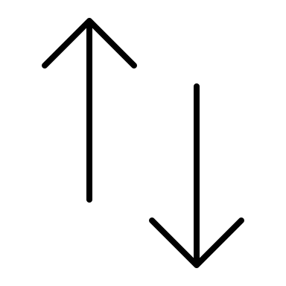
How Does BLE Communicate?
Searching central
One-to-one connection
Advertising
Central
(e.g., iPhone)
one-to-one connection
Peripheral (e.g., AirTag)
https://www.bluetooth.org/DocMan/handlers/DownloadDoc.ashx?doc_id=556599,
Notes:
BLEの説明。ペリフェラルとセントラルがあり、相手を探すときのアドバタイジングを分析する。
Advertising packets are analyzed to classify BLE devices.
BLE is one of the Bluetooth standards.
BLE features lower
power consumption than Bluetooth Classic.
Basically, Smartphones play Central role. Tracking devices play peripheral role.

Slide 38
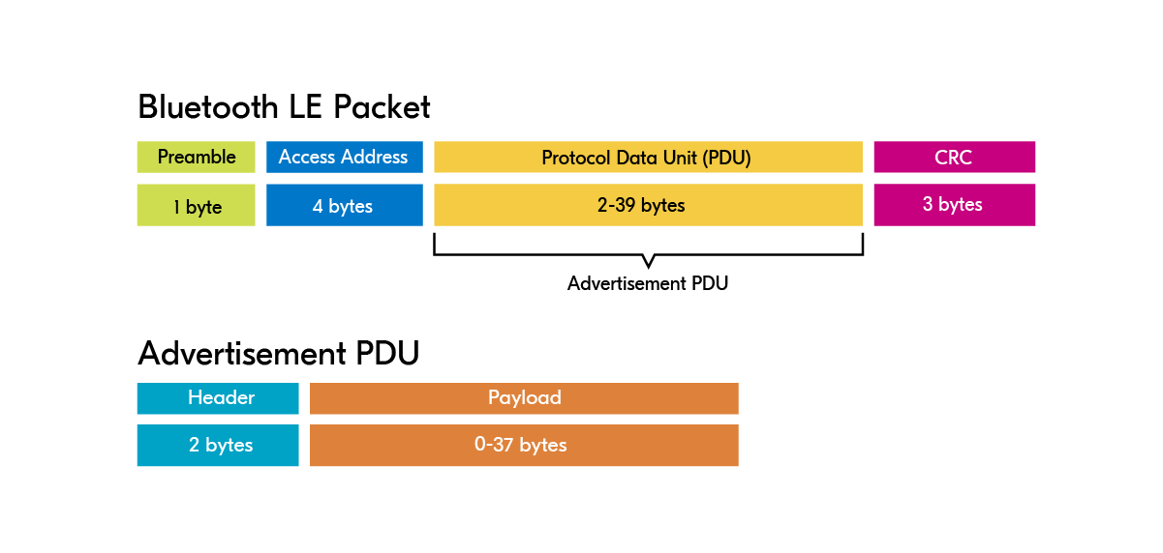
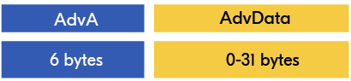
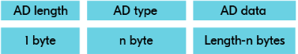
BLE packet structure
High level
BLE Packet
Advertisement PDU
Payload
Adv Data
Low level
https://academy.nordicsemi.com/courses/bluetooth-low-energy-fundamentals/lessons/lesson-2-bluetooth-le-advertising/topic/advertisement-packet/

Slide 39




Synthetic data
Overview of synthetic data
How to generate synthetic data
What is synthetic data?
Synthetic data is artificial data created to mimic real-world data characteristics and structures.
Statistics
What are the benefits of synthetic data?
1
Unlimited data
Machine learning
2
No privacy issue
3
Reduce bias
4
Reduce time costs
Deep learning
5
Reduce monetary costs
https://www.edps.europa.eu/press-publications/publications/techsonar/synthetic-data_en#:~:text=Synthetic%20data%20is%20artificial%20data,undergoing%20the%20same%20statistical%20analysis, https://doi.org/10.1086/722094, https://arxiv.org/abs/2210.07332, https://doi.org/10.1109/ACCESS.2023.3325235, https://aws.amazon.com/what-is/synthetic-data/?nc1=h_ls, https://www.sciencedirect.com/science/article/pii/S0167947311002076, https://ieeexplore.ieee.org/document/9570308
Notes:
[Statistics]
Statistical methods analyze data distribution and create synthetic data based on that distribution. For example, Bayesian inference is used to model the distribution and structure of the data. The data are then synthesized by combining prior and posterior probabilities
[Machine learning]
In methods using machine learning models, data is created by having the machine learning model learn the characteristics of the real-world data. For example, decision trees or random forests are
used to learn the characteristics of the data to produce synthetic data
[Deep learning]

Slide 40








Markov Model
How does Markov model work
Pros and Cons
0.5
Suitable for time-series and structured data
0.4
0.5
0.1
0.5
0.1
Not well-suited for complex data
0.3
0.4
Cloudy
Rainy
Sunny
0.2
https://doi.org/10.1177/0272989X9301300409
40
Notes:
One statistical method for creating synthetic data
only the current state depends on the following state and not on
there is a 50% chance of rain, a 20% chance of sunny, and a 30% chance of cloudy against states

Slide 41






Hidden Markov Model
How does Hidden Markov model work
Pros and Cons
0.5
Observable data
0.7
0.0
0.3
Capable of handling complex data structures
Hidden state
Shop
Walk
Clean
0.4
0.5
0.1
0.5
0.1
Difficult to interpret
0.3
0.4
Cloudy
Rainy
Sunny
0.4
0.3
0.3
0.1
0.5
0.4
Shop
Walk
Clean
0.2
Shop
Walk
Clean
https://www.sciencedirect.com/science/article/pii/S0167865504002922
41
Notes:
hidden Markov model, an extension of the Markov model
Hidden Markov models have both hidden state and observable data. The hidden state cannot be observed directly, so the state is inferred from observable data.
hidden Markov models can be used for more complex problems because they can include dependencies between hidden states and observable data

Slide 42





GAN (Generative adversarial networks)
How does GAN work
Pros and Cons
Noise
Generator
Fake Data
Ensuring data diversity
Real
Discriminator
Not well-suited for structured data
Real Data
Fake
arXiv:1406.2661
42
Notes:
GAN consists of two neural networks, called Generator and Discriminator
By repeating this process, the Generator learns to generate data that the Discriminator judges as real data, and the Discriminator learns to discriminate more correctly. In this way, the Generator and Discriminator evolve in competition with each other to generate more realistic data

Slide 43



Previous research (I am expanding his research)
What he did
Limitation
Created a database of BLE
30 million packets of data were collected from a wide variety of devices
Controlled environment
Accuracy
Real-world environment
99%
80%
Built a model to classify BLE
A machine-learning model to classify BLE trackers was created.
I used this dataset to generate synthetic data
I will use this model to evaluate the generated data
Increase data diversity to improve accuracy by generating synthetic data
Stefan 2024

Slide 44

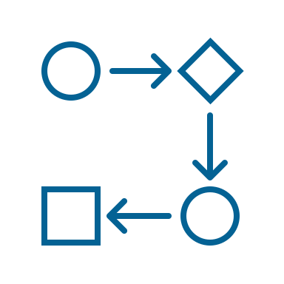
Related works
Relating to BLE
Creating synthetic data using Markov model
Generated synthetic data relating to BLE
RSSI data used for BLE beacon location tracking
IP packets and TCP/UDP flow
Used the Markov model
High-resolution solar radiation data
Wind speed data
Conducted simulation relating to BLE
Multiple BLE advertising packets colliding
BLE wireless sensor networks
Used the Hidden Markov model
Financial time series data
Population data
No studies have generated synthetic data for BLE
The Markov model is used to generate
synthetic time series and structured data
https://ieeexplore.ieee.org/document/9366479, https://theses.hal.science/LAAS-RISC/hal-04797964v1, http://dx.doi.org/10.1109/ACCESS.2018.2866323, http://dx.doi.org/10.3390/jsan9030038, https://www.sciencedirect.com/science/article/pii/S0038092X14001042, https://ieeexplore.ieee.org/document/9687770, http://dx.doi.org/10.1080/14697688.2015.1004801, https://www.sciencedirect.com/science/article/pii/S0191261515300904

Slide 45


Overview of related works
Research
Synthesize BLE
packet data
Related
Markov model
Time series data
Can this be used to create synthetic BLE packets?
Synthesizing data
Simulation
Not Hidden
Hidden
Method
Data
1
Partially
2
Partially
3
Partially
4
Partially
5
Partially
6
7
8
9
10
11
This Research
Yes
Yes
No
Yes
No
Yes
Yes
Yes
Notes:
There are no existing studies that have focused on synthesizing BLE packet data. Markov Models are commonly used for synthesizing time-series data.

Slide 46
Executive Summary
Introduction
Background
Index
Design
Implementation / Evaluation Plan
Conclusion

Slide 47

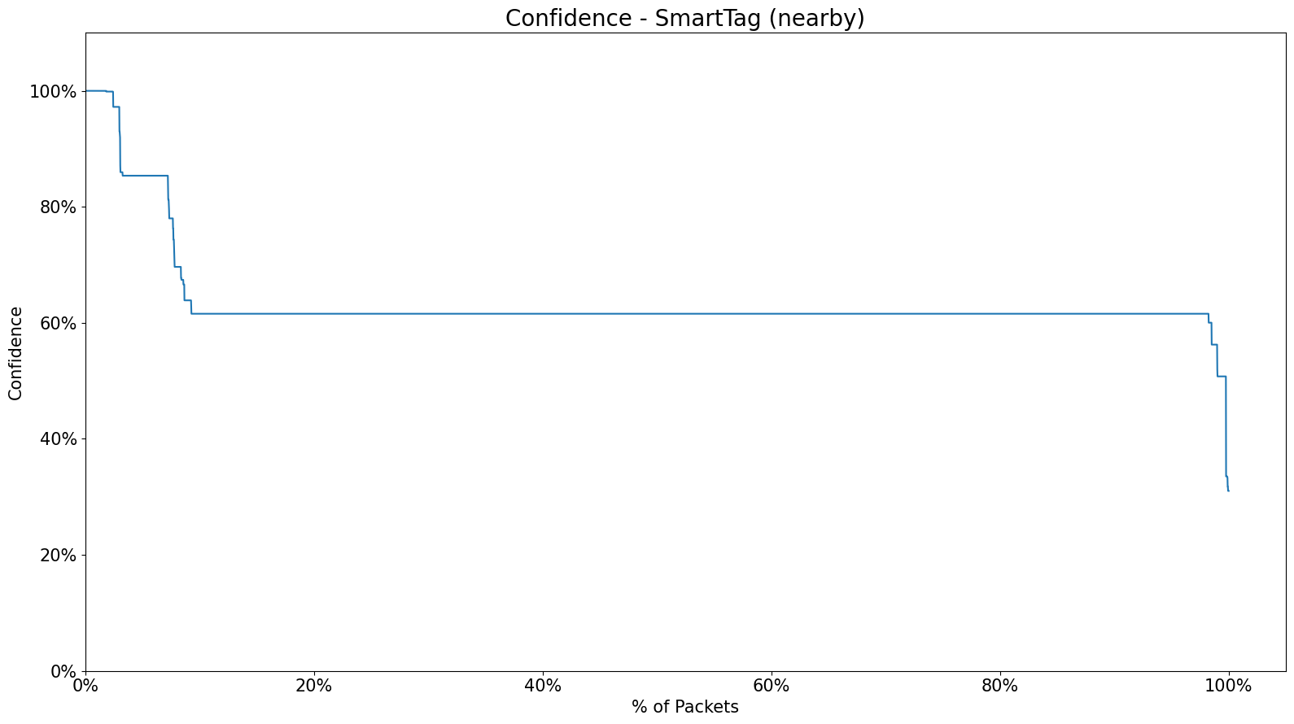
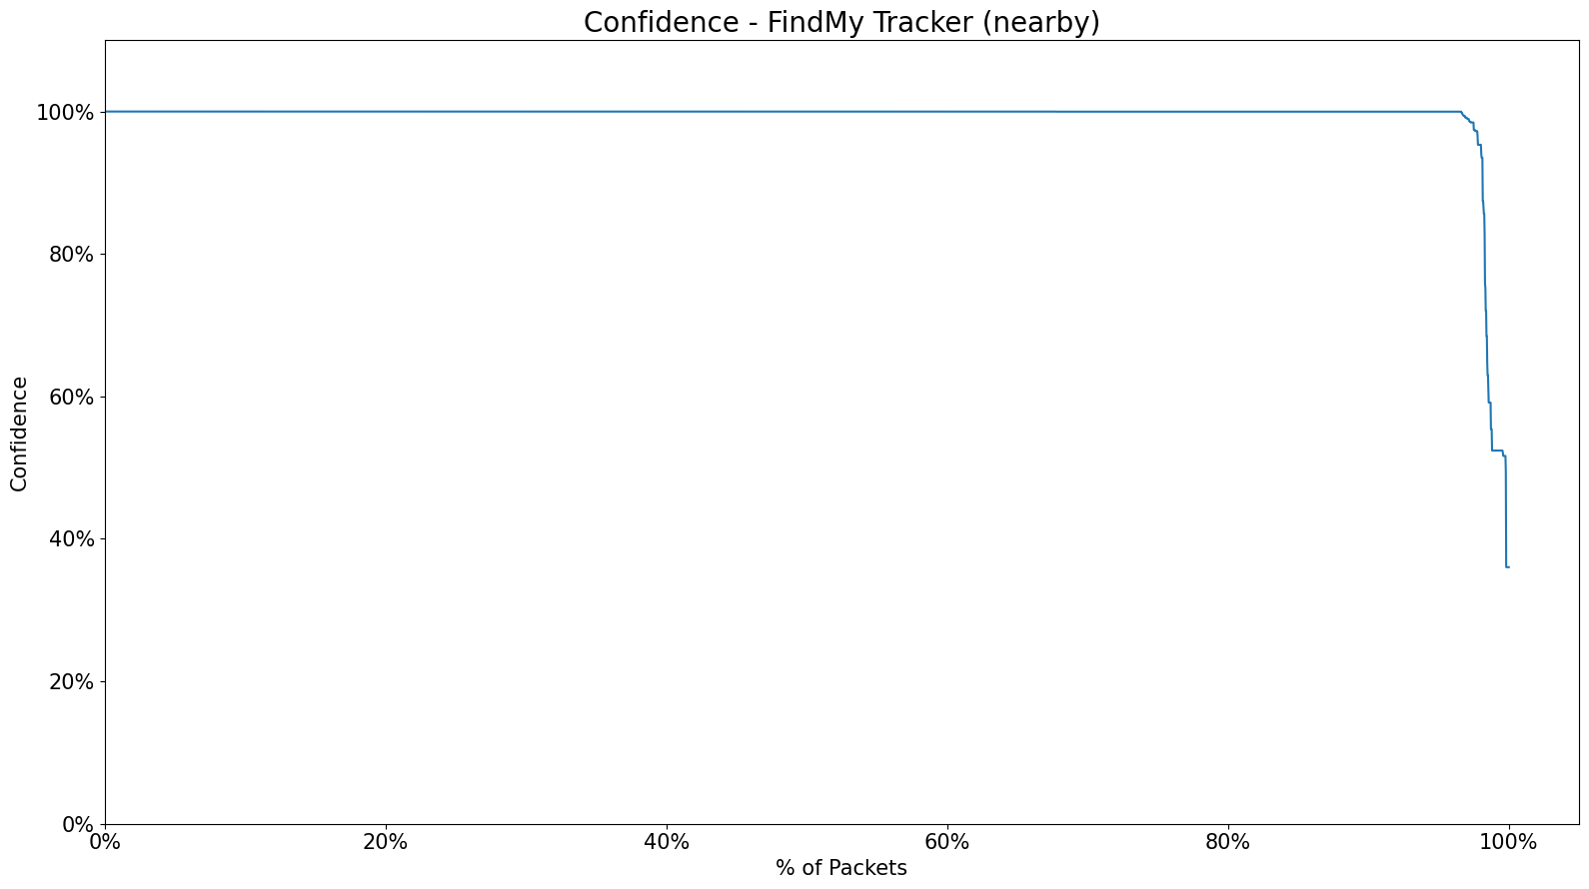
Data Selection
Number of packets
Accuracy
47
Notes:
Sorting data in order of ACCURACY

Slide 48
Executive Summary
Introduction
Background
Index
Design
Implementation / Evaluation Plan
Conclusion

Slide 49



Implementation plan
Run Markov model
Run a Markov model for each group of grouped columns
Group columns
Treat highly related columns as the same state
Investigate columns
Investigate the number of unique values for each column

Slide 50
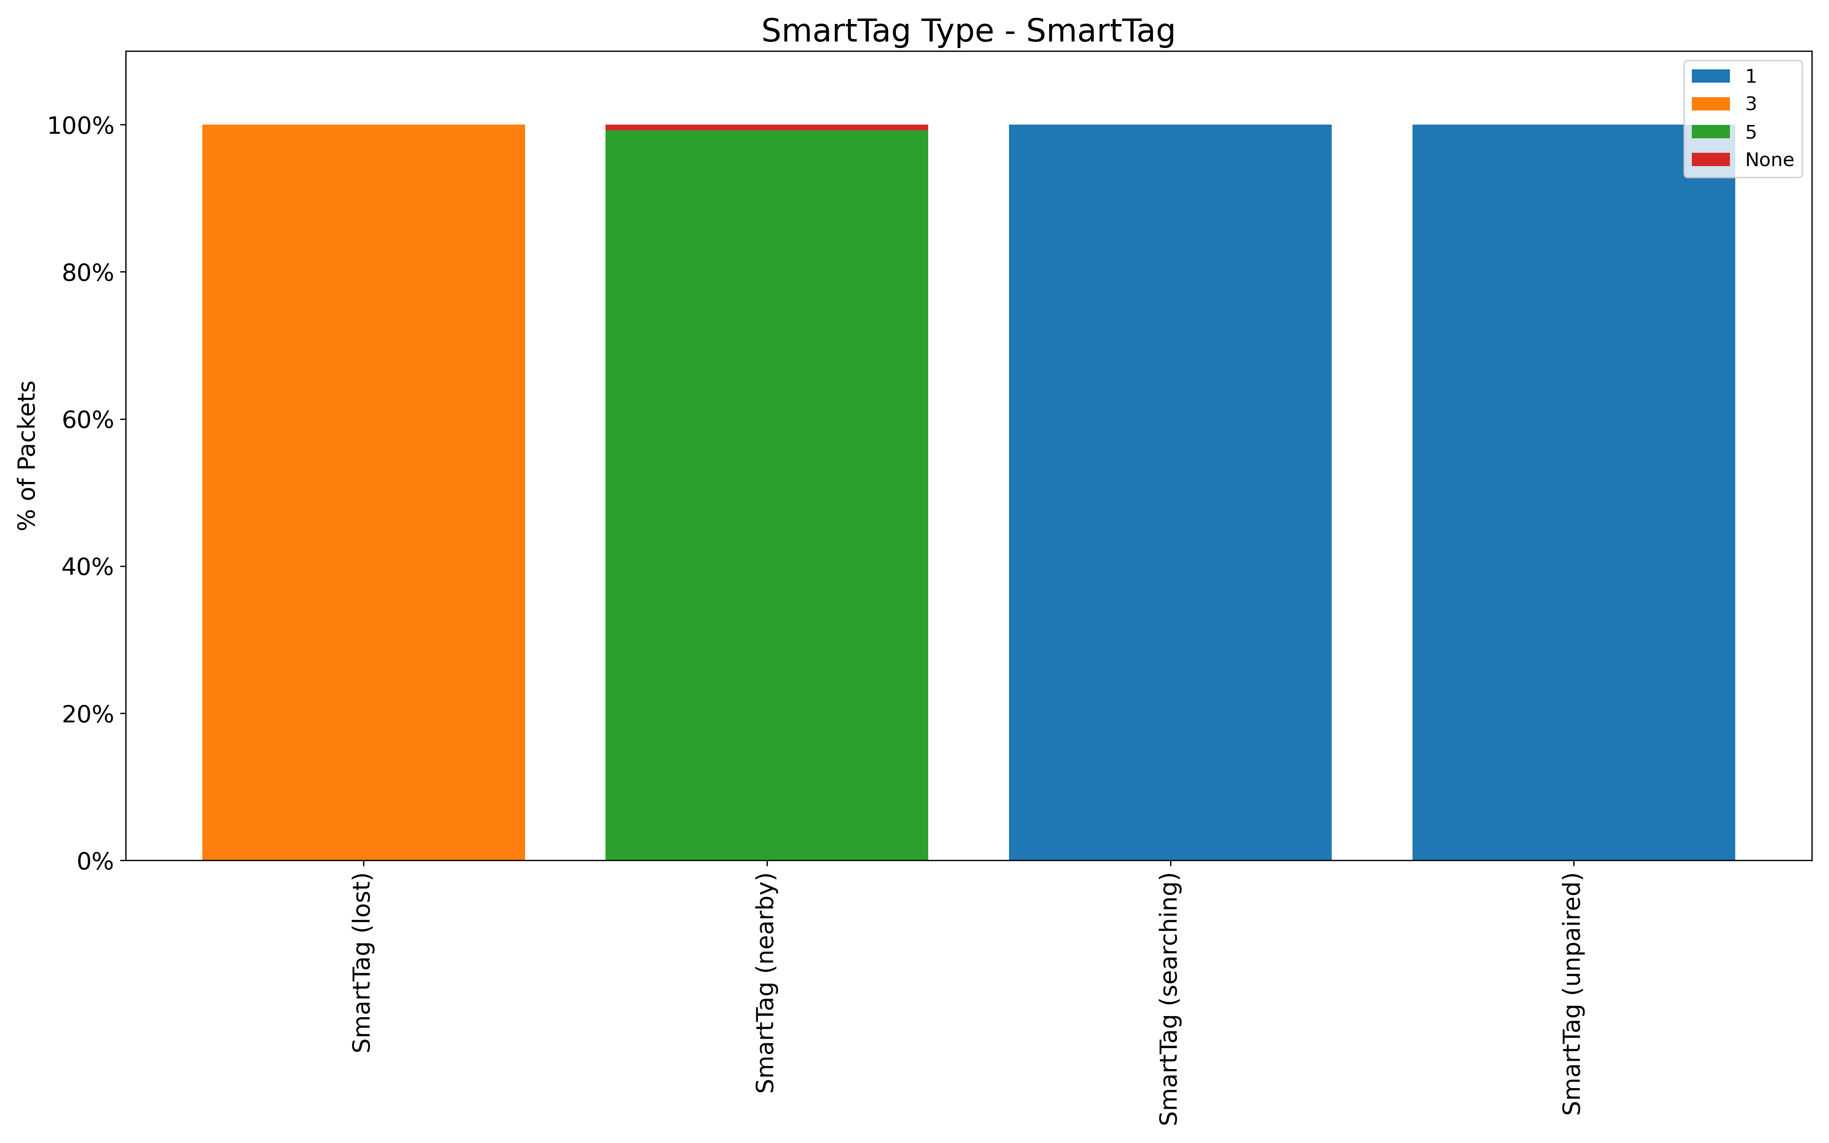
Evaluation plan
Data Structure
Confidence Lebel
Compare the structure of data with synthetic data and original data.
Compare confidence levels between models with and without synthetic data.
Stefan’s Github
Notes:
The next task is to evaluate the synthetic data. The evaluation will be conducted from two perspectives.

Slide 51
Executive Summary
Introduction
Background
Index
Design
Implementation / Evaluation Plan
Conclusion

Slide 52



Conclusion
Confirmed the suitability of the Markov model
Will execute implementation and evaluation plans
Targeted
SmartTag (nearby)

Slide 53
Questions?

Slide 54
Appendix

Slide 55
Data Selection (Number of packets)
55

Slide 56
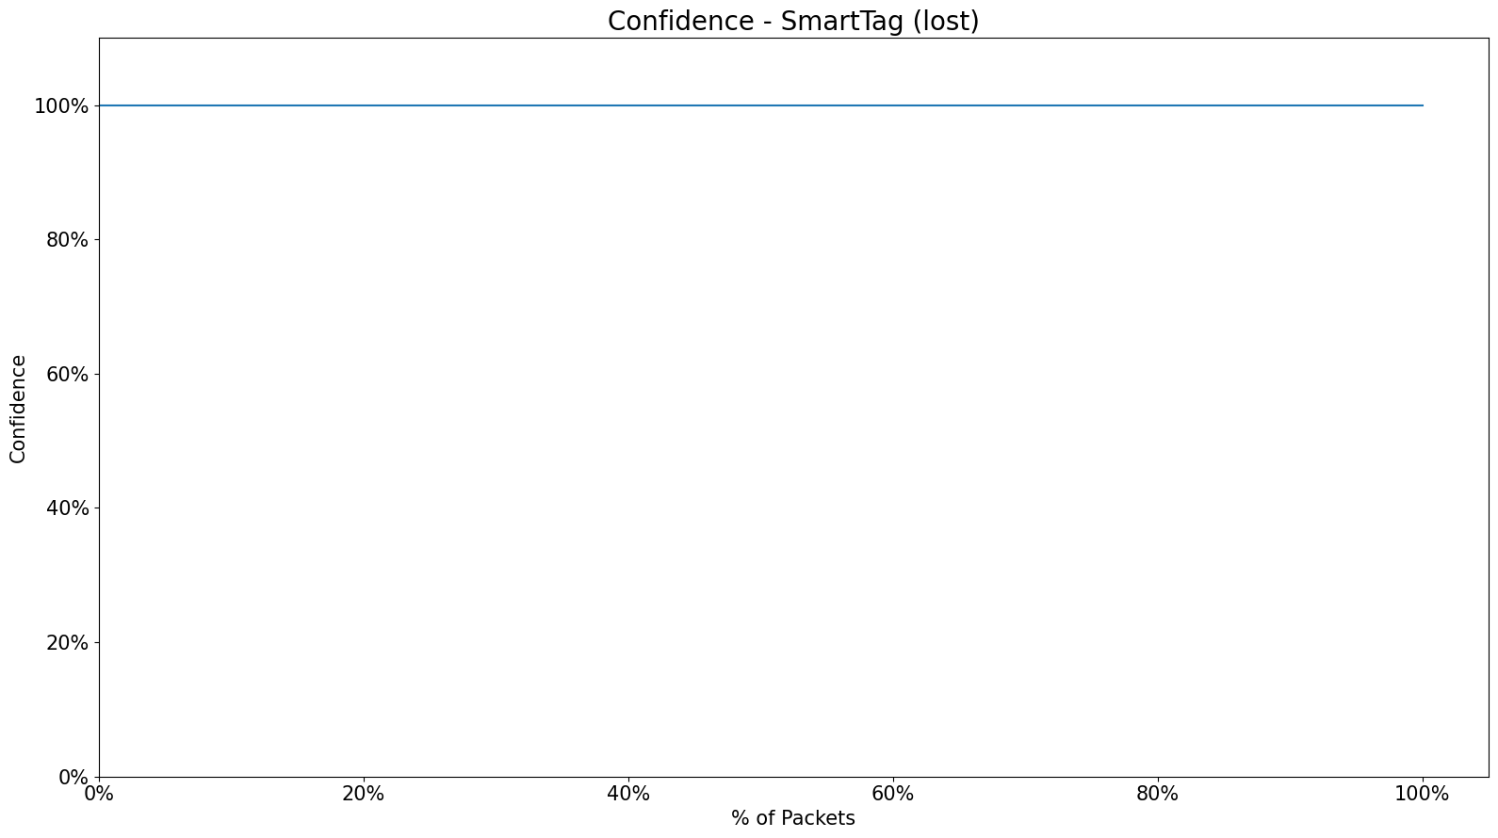
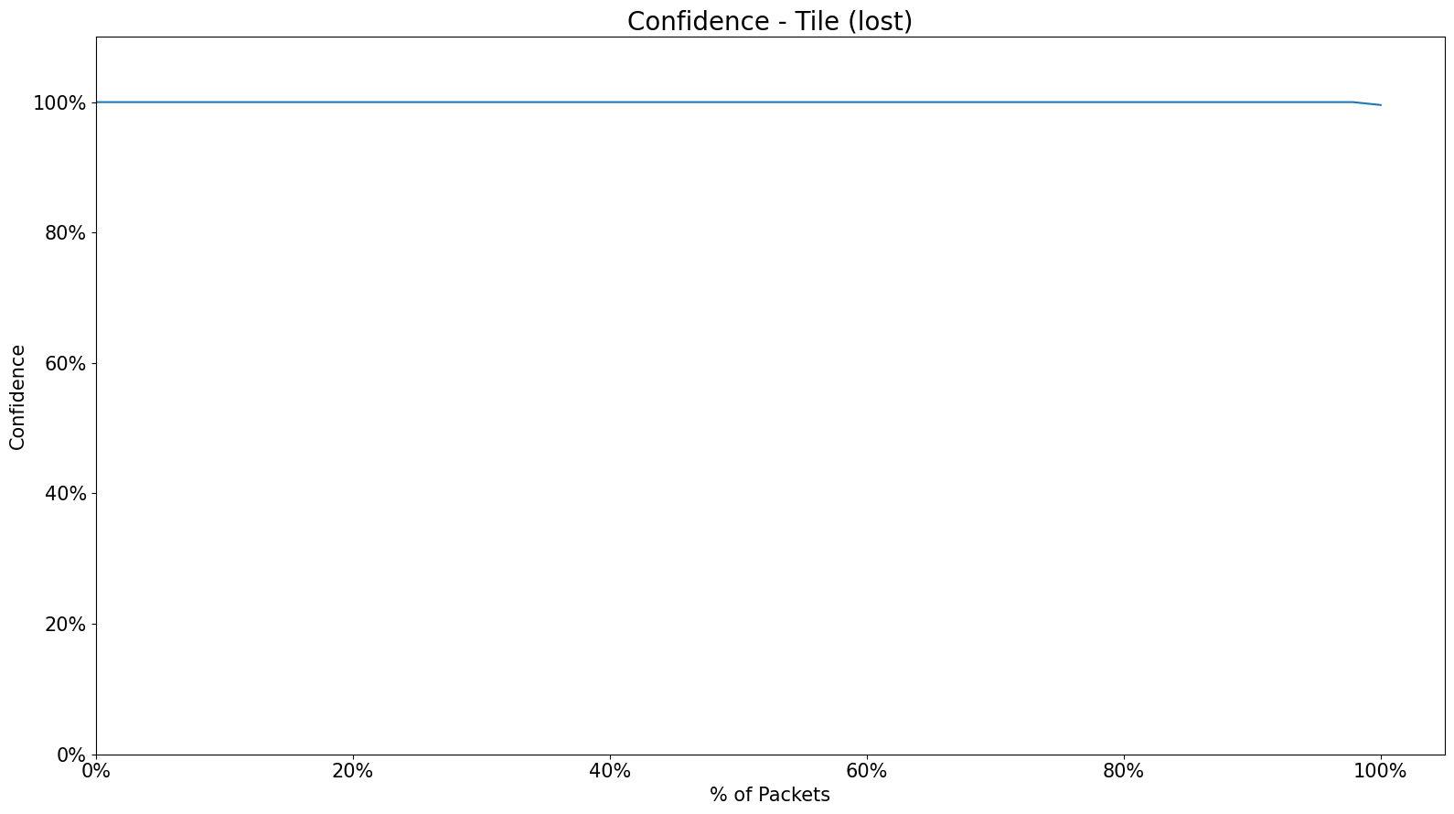
Data Selection (Accuracy)
56

